Slide 1
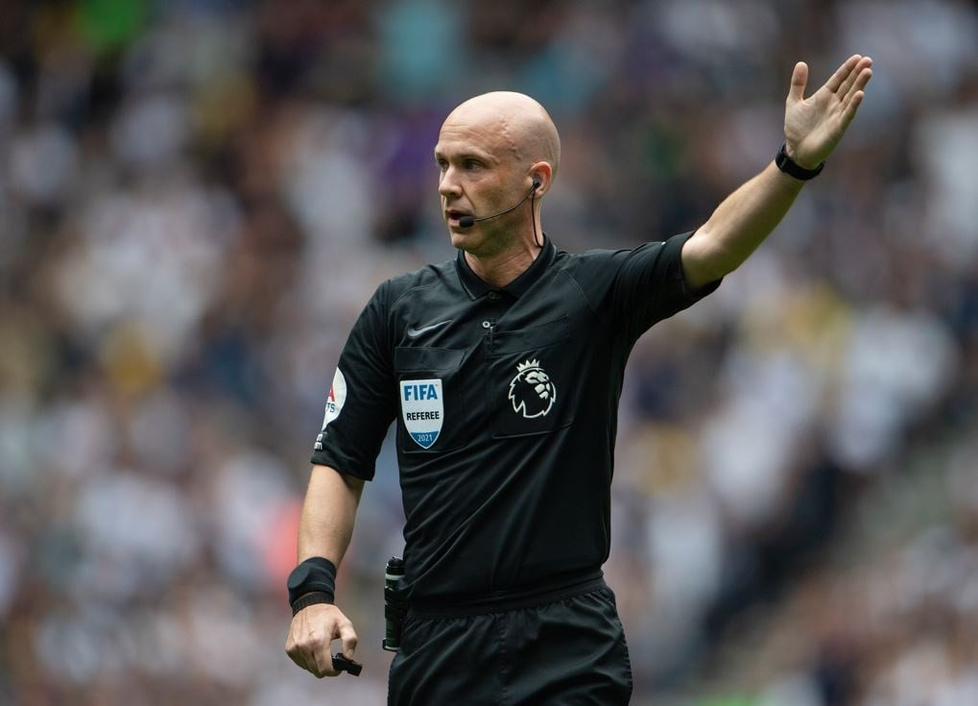

A useful frame for what AI is — and isn’t — for our profession.
Can AI replace the referee?

Slide 2
Engineers Engineering Again
Where AI Belongs in Railway Design & Assurance
Bill Guo FICE CEng MEng
Founder | AutomateX Advisory
BAM Nuttall EM Forum | Sundridge | 7 May 2026
Engineering Excellence Amplified

Slide 3
Same week, different seat
2016–2021
2023–2025
The Client
The SME
NR DPE/PE — Southern Region. Lead engineer on CP6 buildings; what good (and bad) assurance looks like from the asset owner’s seat.
Director of an SME consultancy — scaled the business from a standing start to a framework-winning team
01
02
03
04
2021–2023
2026–Now
The Large Consultancy
The Startup
HS2 Engineering Manager. Delivering inside a tier-1 environment — process, governance, and scale at programme level.
Founded AutomateX — working on the responsible and effective use of AI to free rail teams up for things that matter.
automatex.uk

Slide 4
Where the week actually goes
CEM
CRE
PM
Engineering Manager
Responsible Engineer
Project Manager
Drowning in DRN ping-pong, signatures, and doc controller tasks
Form drafting eats the scrutiny time.
Death by reporting and tracking.
Design
Site
Survey
Designer
Section Engineer
Surveyor
Hunting clauses, files and others’ memories
Waiting on AFCs before possessions.
Retyping into someone else's template 100 times over.
Much of time are eaten up by tasks that are repetitive, low-value adding and laborious, where possession-driven programme put every other Friday in fire-fighting mode.
automatex.uk

Slide 5
Is AI the answer?
No.
Yes.
Not to the things that need a signature.
To the work that bleeds time around the signature.
Engineering judgement, accountability, and the CEM/CRE/PE seat — not for AI to take.
Standards interpretation, risk acceptance, and the safety case stay with the humans named on the form.
Drop AI into those decisions and you trade visible work for invisible error.
Drafting Form Gs, Form Cs, AIPs, DRN responses — high frequency, low judgement.
Surfacing the right standard, the right clause, the last accepted submission, in seconds.
Catching the inconsistency before it becomes a defect — not after.
…if it's implemented systematically. Wrong place, wrong guardrails, and AI is worse than not using it at all.
automatex.uk

Slide 6
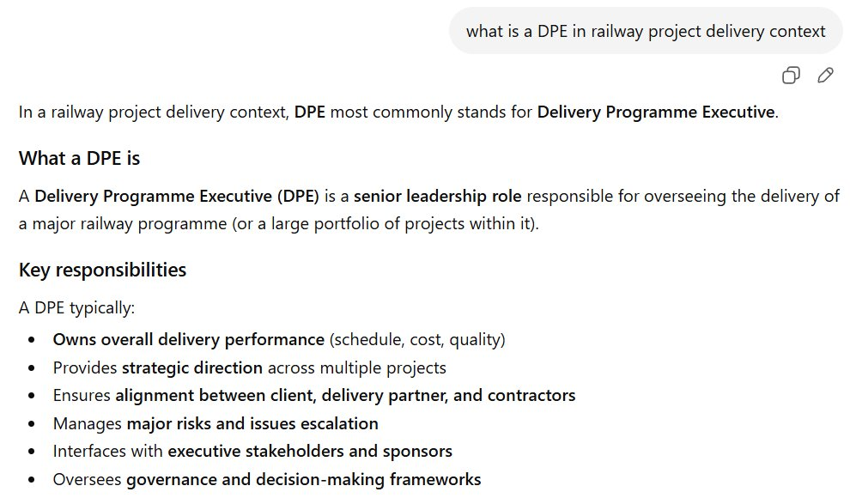
To find the X we need to know the tool — what it can do and can’t do
What AI is, and what it isn't
Confident. Wrong.
I asked a leading AI tool what a DPE is. There is no Delivery Programme Executive. A DPE is a Designated Project Engineer under NR/L2/RSE/02009. The model invented a plausible answer because the right one isn’t on the public web. This is why generic AI cannot do our work — and why proper deployment must sit on our standards, our templates, our project memory.
Asked this morning. Confidently invented.
automatex.uk

Slide 7
Where the line is, today.
AI is good at
AI is not for
Retrieving a clause from 400 pages of standards.
Drafting a Form G from source documents.
Cross-referencing your DRN against design history.
Deciding which clause applies to your situation.
Deciding whether a derogation is acceptable.
Owning the engineering accountability for the answer.
automatex.uk

Slide 8
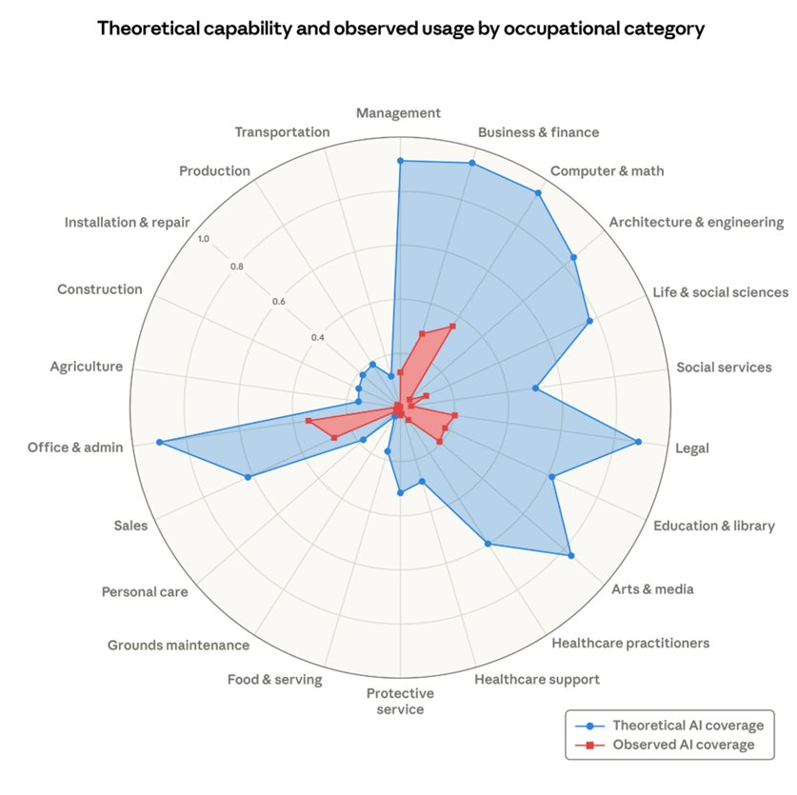
Mind the gap.
Anthropic’s data on AI capability vs. observed adoption, by occupation.
Architecture & Engineering: high theoretical coverage, low actual usage. The gap is one of the largest on the chart.
Source: Anthropic Economic Index (anthropic.com/research/labor-market-impacts).
automatex.uk

Slide 9
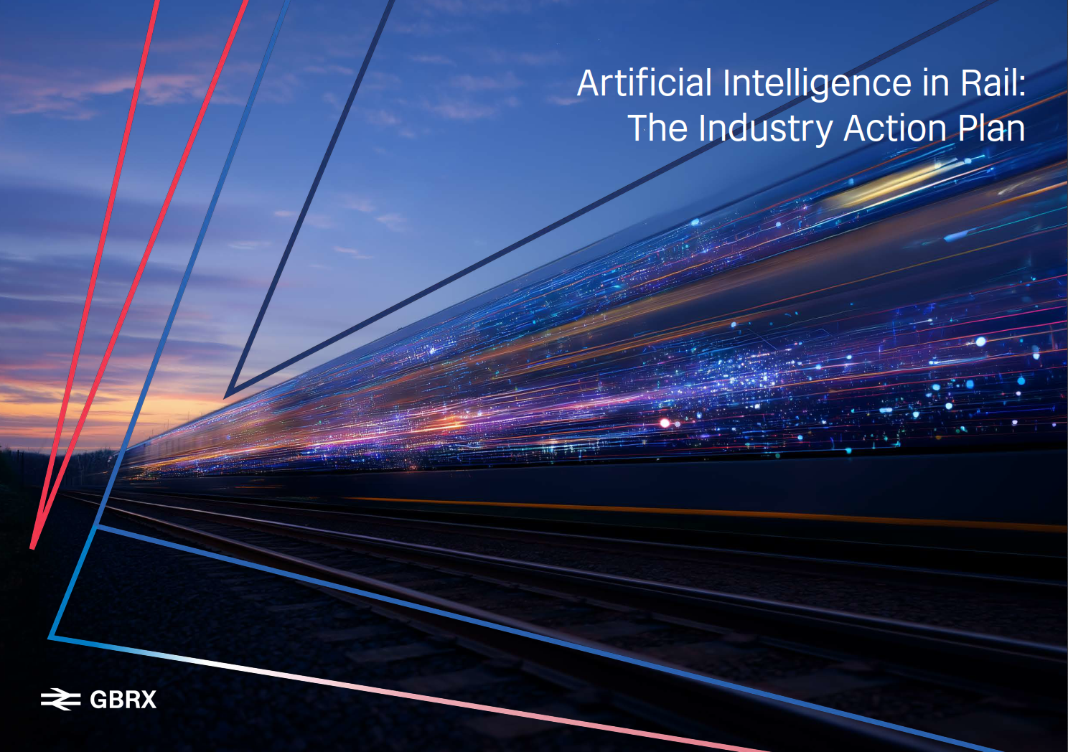
GBRX AI Action Plan, April 2026
“..AI creates opportunities to improve tasks and workflows in ways that are beneficial for people.
Human centred tools can reduce manual and repetitive tasks, support or automate activities that add limited value, freeing people to apply their judgement and experience on those activities that matter most.
Used appropriately, AI should make day-to-day work better, safer and less administratively burdensome..”
Source: https://gbrx.co.uk/
(anthropic.com/research/labor-market-impacts).
automatex.uk

Slide 10
What we’re building
01
02
03
For Contractor/Consultancy
For NR
Company/Project Brain
Scribtive
InstaTrace
InstaDoc
Requirement
Assurance
Document Drafting
Enterprise-grade knowledge graph: your standards, your project/company memory. Searchable, traceable, integrated.
automatex.uk

Slide 11
▶
Scribtive in action.
Form G generation from source documents — and where it still needs the engineer.

Slide 12
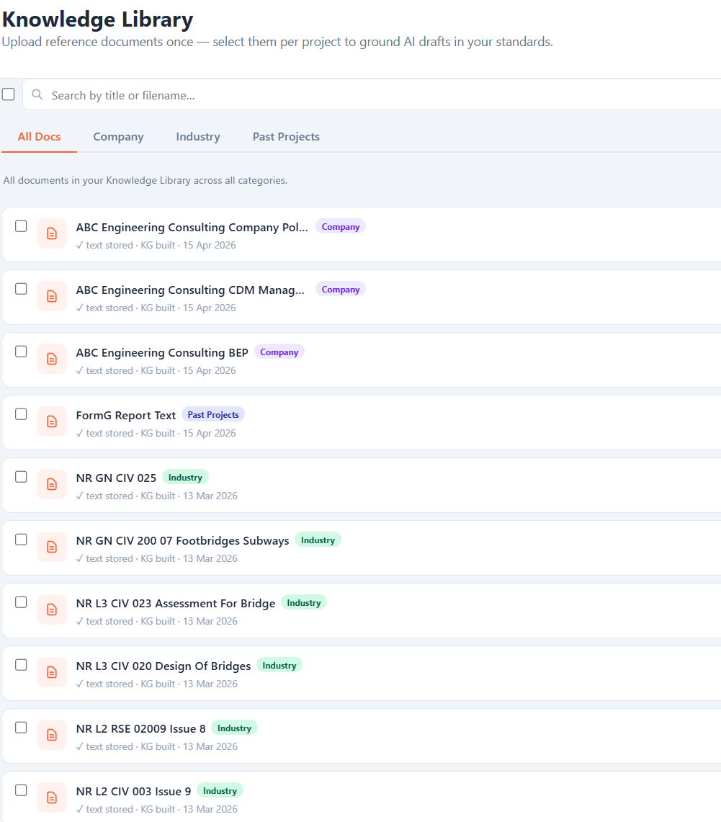
01 · KNOWLEDGE
Knowledge Library
Upload your standards, BEPs and templates once. Every draft cites them — not the public web.

Slide 13
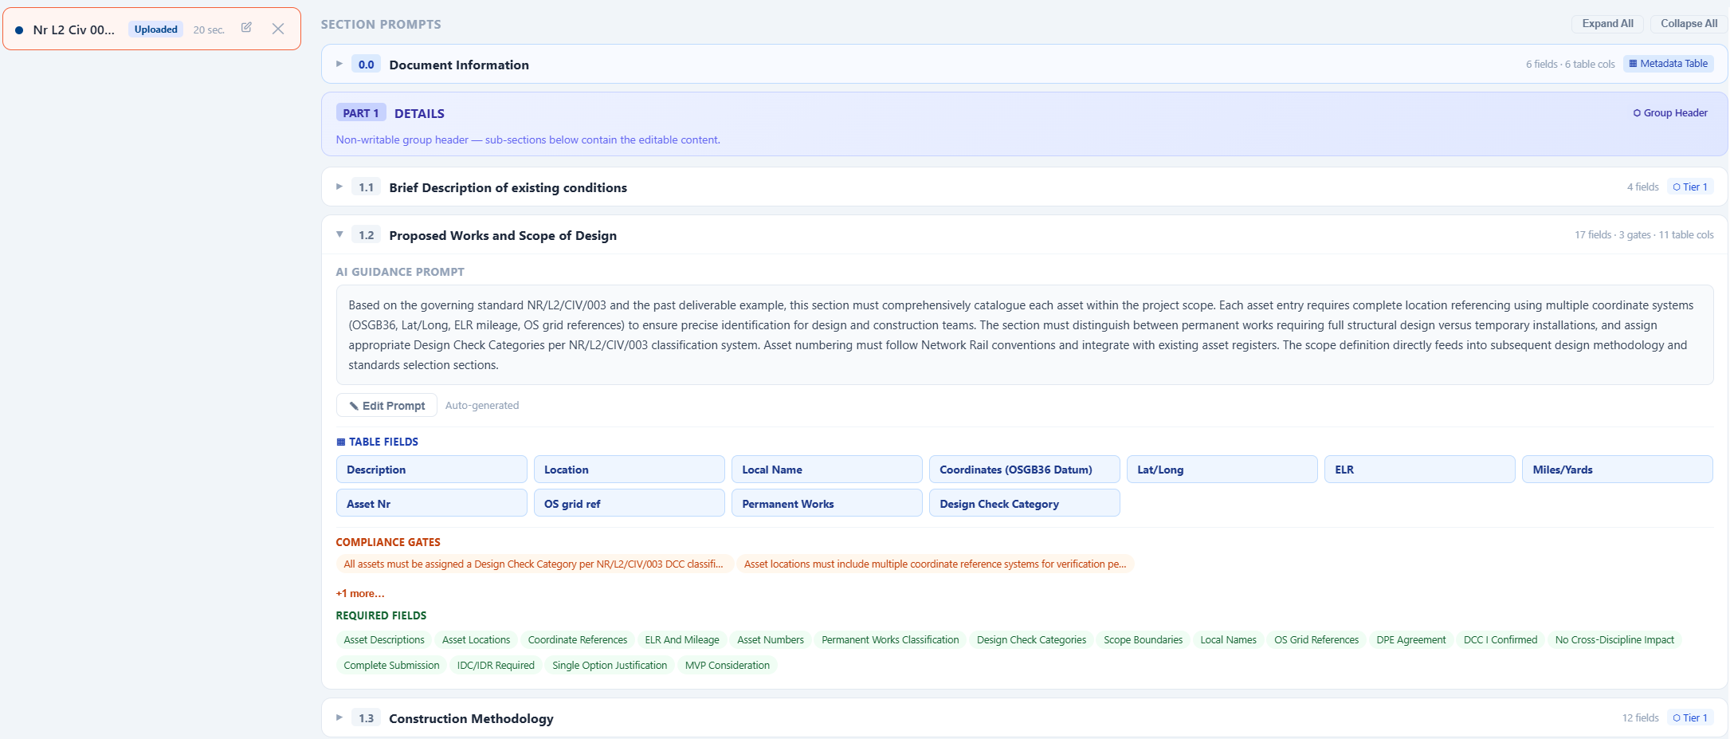
02 · TEMPLATES
Templates with engineering intent
Form G, AIP, FormC — section by section, with the prompt the AI must follow and the fields it has to fill.

Slide 14
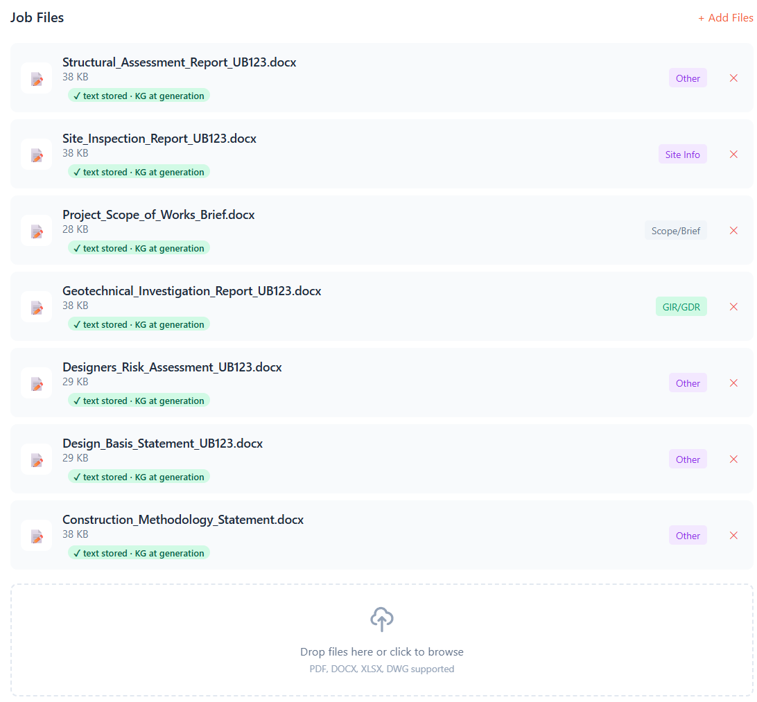
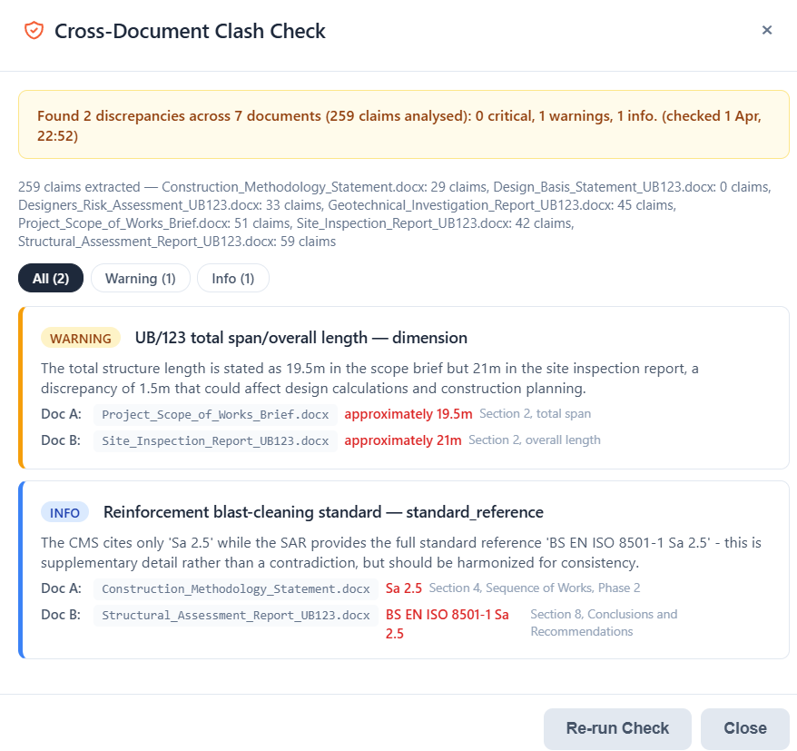
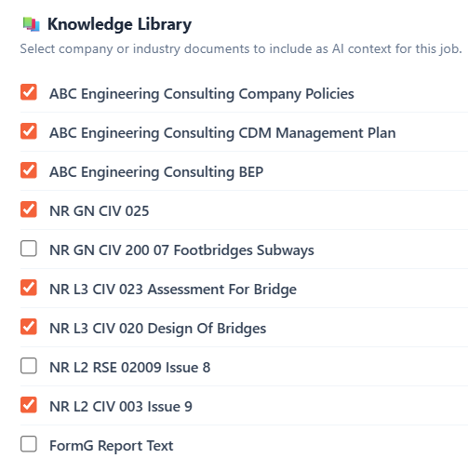
03 · JOB SETUP
One job, one source of truth
Project docs, asset details, clash check, generated outputs — versioned, traceable, in one place.

Slide 15
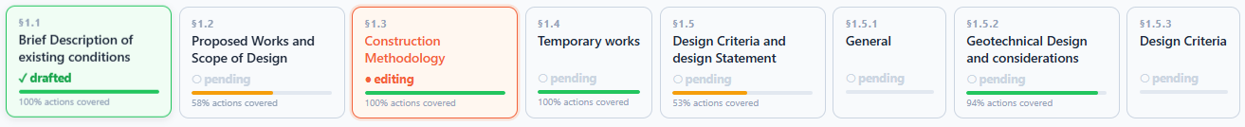
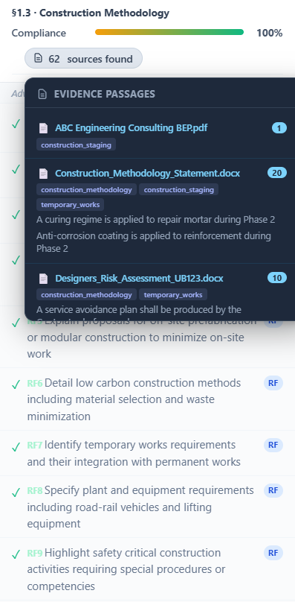
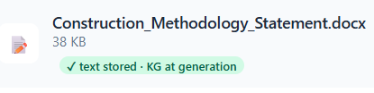
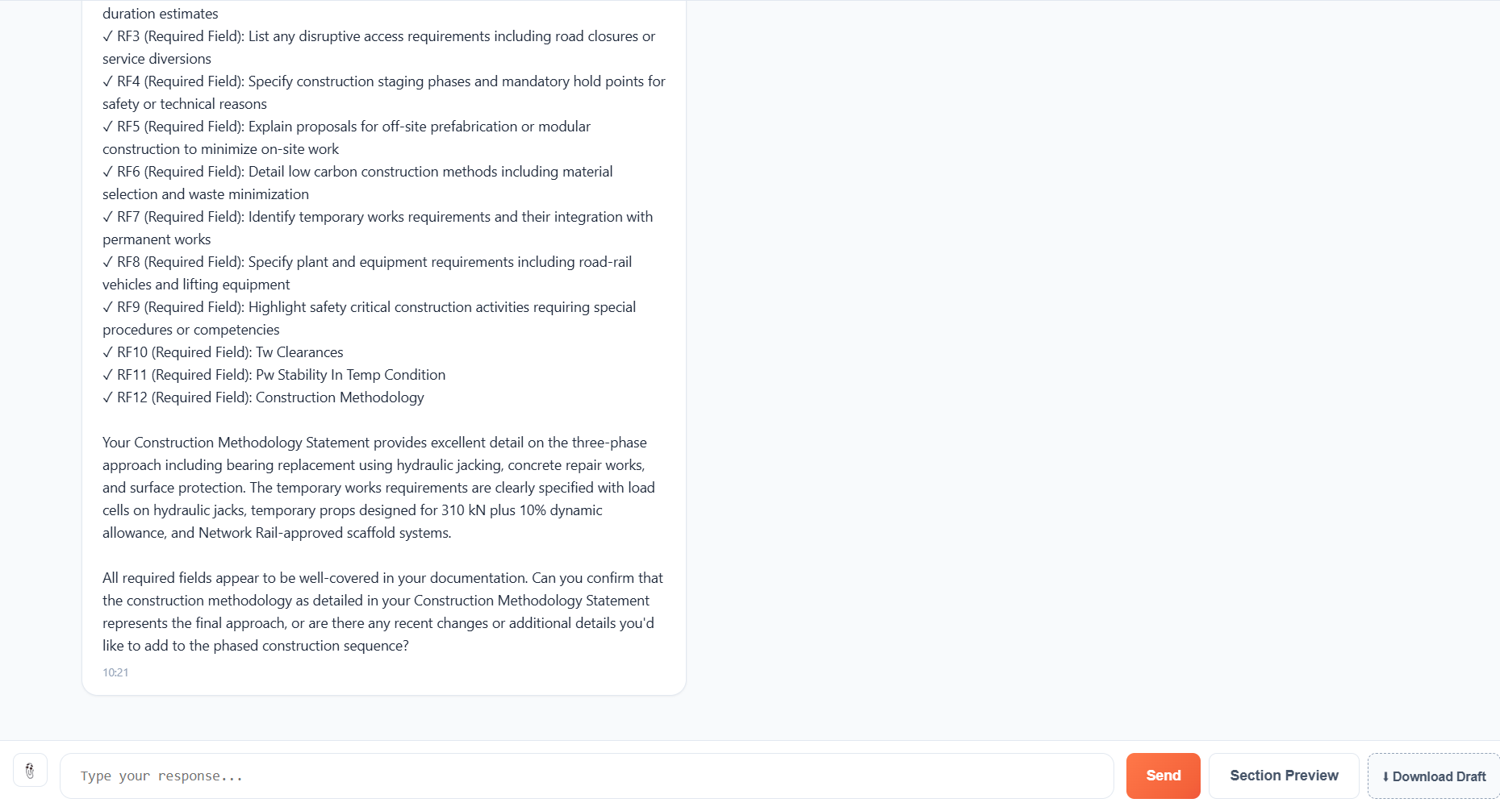




04 · GENERATION
Drafting that flags what doesn't add up
Section-by-section drafting from your sources — and a cross-document warning when the numbers disagree.

Slide 16
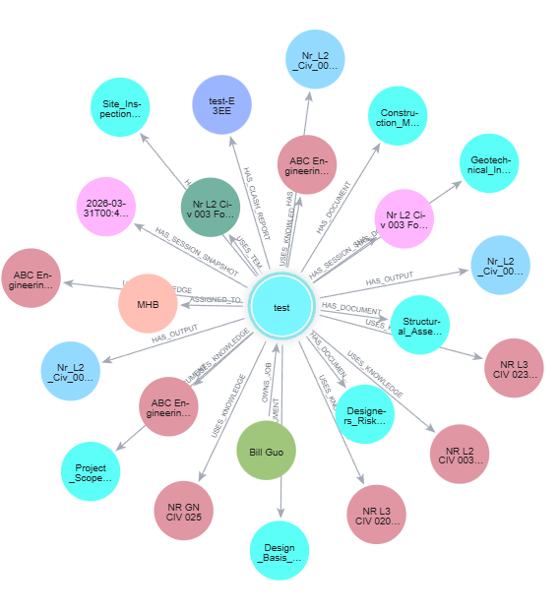
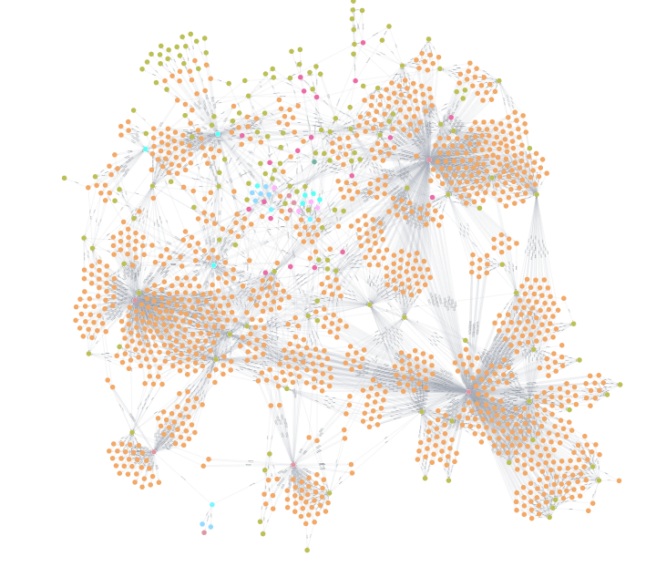
05 · What’s behind this
How would an engineer search through knowledge
Knowledge navigation and traversing based on Railway’s specific taxonomy and ontology. No hallucination

Slide 17
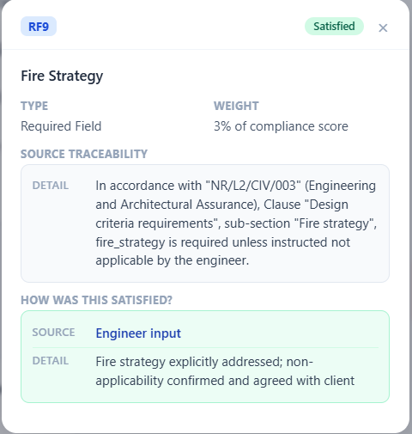
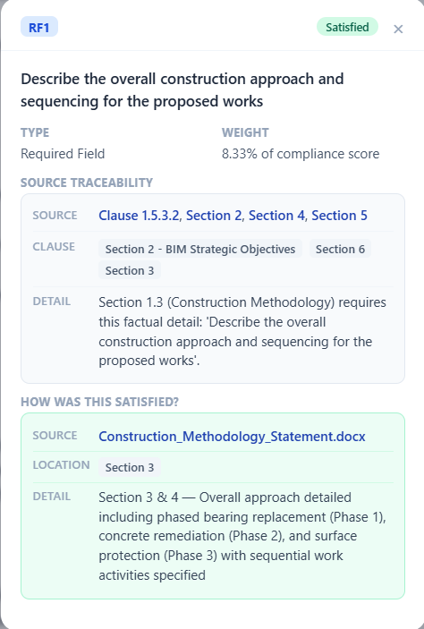
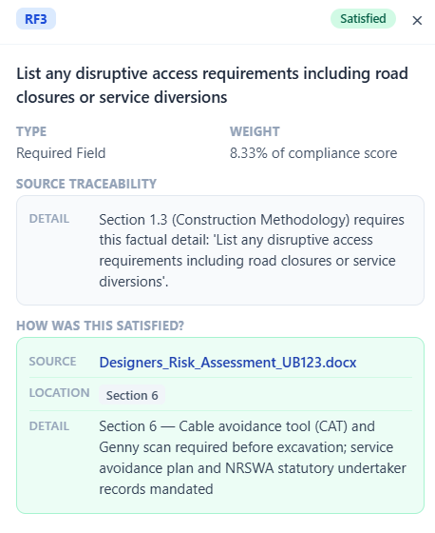
06 · TRACEABILITY
Every required field, traced to source
Source clauses, satisfaction evidence, and engineer-confirmed exceptions — for every field a Form G demands.

Slide 18
VISION
The PACE Operating System
What we're really building.
IMAGINE THE NEW ENGINEER
IMAGINE THE FORM G THAT LANDS
Walks into their first railway project. Not intimidated by 14,000 NR standards on top of everything else they have to hold in their head. The tools meet them at the page that matters.
Submitted confident every corner is covered, every consideration demonstrable. CAT1 acceptance in 3 days — not 2 weeks of back-and-forth.
Amplify, not replace.
So engineers can be the best engineer they want to be — not the best admin.
Same idea as the referee — better tools, sharper judgement, fewer missed calls in less time taken.

Slide 19
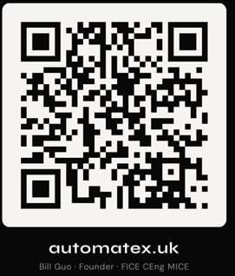
What might be your X.
X = part of your workflow that are
Low engineering judgement
Repetitive
Time-consuming
Laborious
Error-prone
Scan the code to join the AutomateX waitlist — early access for engineering teams trialling Scribtive on live jobs. Our next cohort start in July.
Bill Guo — Founder
bill.guo@automatex.uk · automatex.uk
linkedin.com/in/bill-guo-ceng-mice-b0114681

